Slide 1

Angular

Slide 2
Agenda
Introduction to SPA
Angular File Structure
Angular CLI
TypeScript
Angular Forms
Component Communication in Angular
Routing
Consuming a REST API with Angular

Slide 3
Introduction to SPA
What is Single Page Application (SPA),
Difference between AngularJS and Angular

Slide 4
What is Angular?
Angular (formerly called Angular JS) is a typescript based web application framework that supports full-stack development for building all types of web applications.
It helps in creating reactive single page application (SPA) and is completely based on the concept of components.
Angular is owned by Google, and its stable version was released on September 14, 2016. Angular's official website is https://angular.io/.
Google makes sure that they release a major version of Angular every 6 months.

Slide 5

Single-page applications are web applications or a special type of website that provide users with a very intuitive, responsive, and fast user experience.
It is enriched with menus, multiple blocks, tiles, and interactive buttons on one page, helping users easily navigate the application.
This helps to dynamically load a portion of the current page instead of reloading the entire page from the server.
This is why angular based applications are called reactive fast speed loading pages.

Slide 6
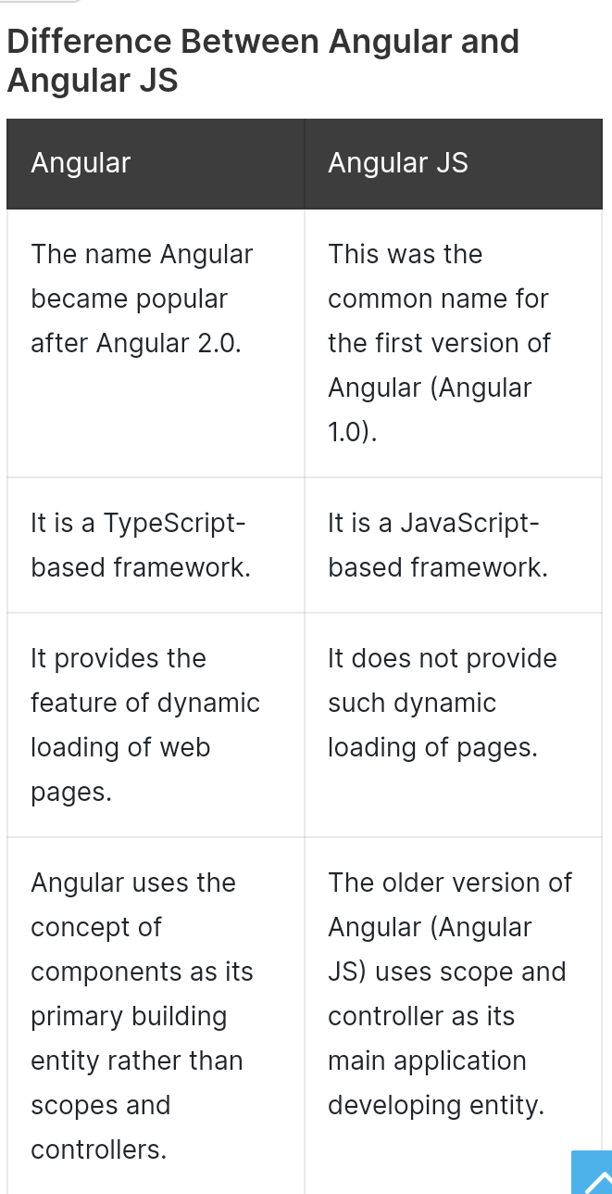

Slide 7
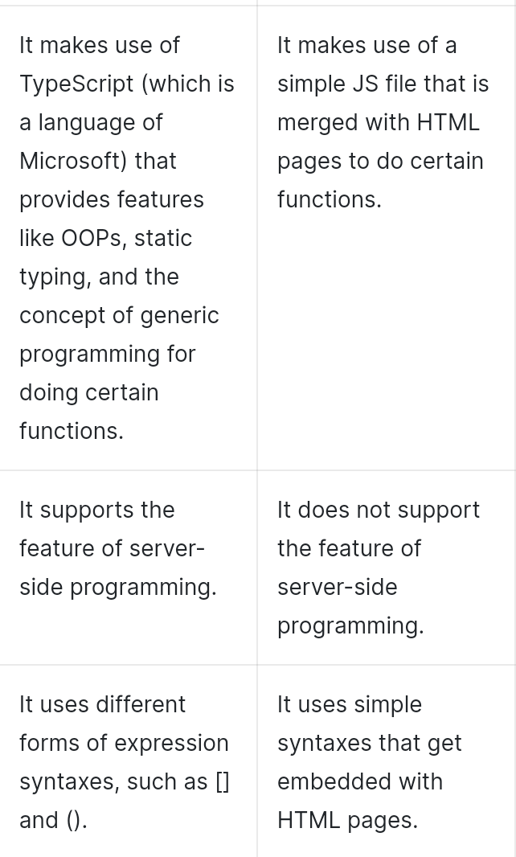

Slide 8
Angular File Structure
Angular Structure,
App Module,
Core Module,
Shared Module,
Feature Modules,
Styles,
Assets

Slide 9
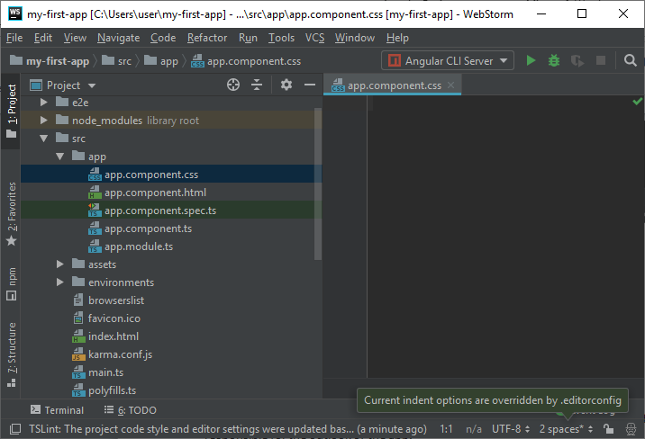

Slide 10
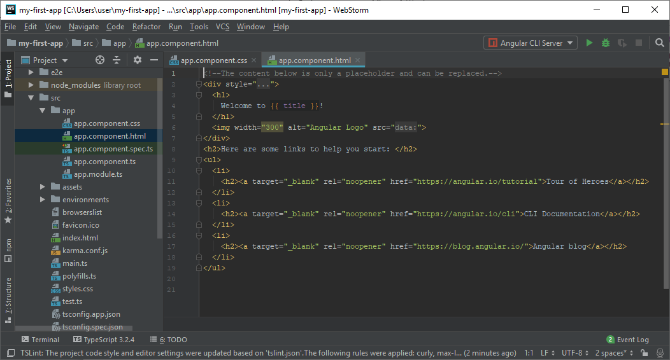

Slide 11
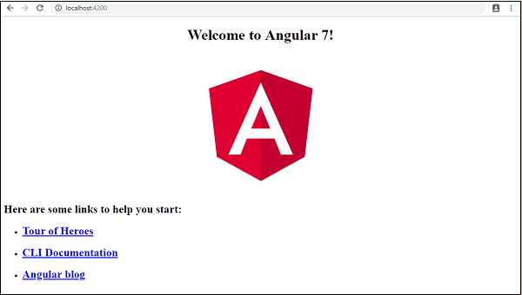

Slide 12
Angular CLI
CLI overview,
Commands overview,
Creating a project,
Running a project,
ng add, ng build, ng config, ng new, ng run

Slide 13
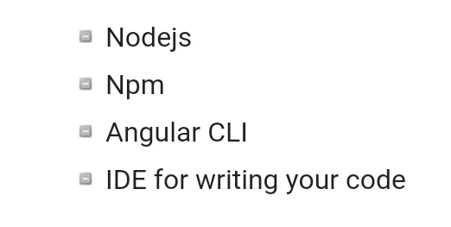
To install Angular 7, we require the following −

Slide 14
Install Visual Studio Code IDE or JetBrains WebStorm or Eclipse IDE
You must have an IDE like Visual Studio Code IDE or JetBrains WebStorm to run your Angular 7 app.
VS Code is light and easy to setup, it has a great range of built-in code editing, formatting, and refactoring features. It is free to use.
It also provides a huge number of extensions that will significantly increase your productivity

Slide 15
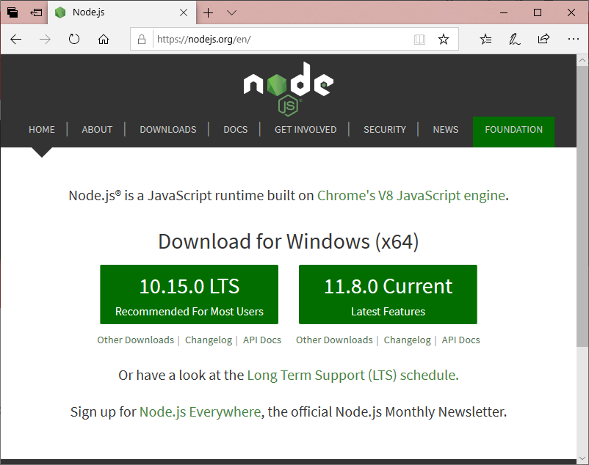
Install Node.js
You should install node.js to run your Angular 7 app. It manages npm dependencies support some browsers when loading particular pages.
It provides required libraries to run Angular project. Node.js serves your run-time environment as your localhost.

Slide 16

Use npm to install Angular CLI
The Angular CLI (command-line interface) is a great tool to efficiently build Angular application by automating operations in Angular projects rather than manually.
Run the Angular CLI command to install Angular CLI

Slide 17
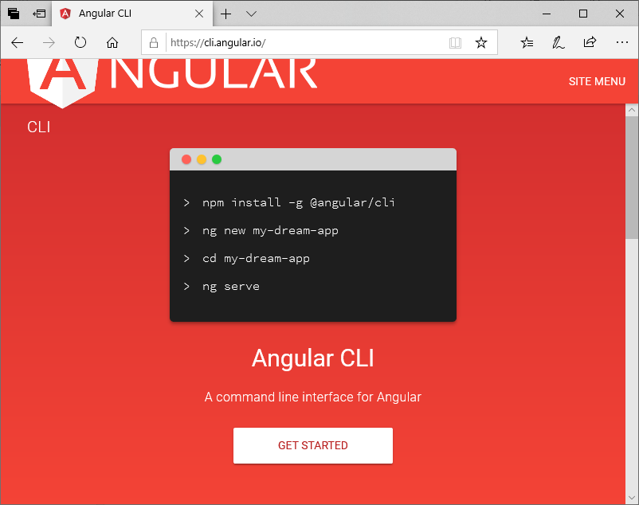

Slide 18
TypeScript
TypeScript vs JavaScript,
Transpilation,
tsconfig.json,
typings

Slide 19
What is JavaScript?
JavaScript is a scripting language which helps you create interactive web pages.
It followed rules of client-side programming, so it runs in the user's web browser without the need of any resources forms the web server.
You can also use Javascript with other technologies like REST APIs, XML, and more.

Slide 20
What is Typescript?
Typescript is a modern age Javascript development language.
It is a statically compiled language to write clear and simple Javascript code.
It can be run on Node js or any browser which supports ECMAScript 3 or newer versions.

Slide 21
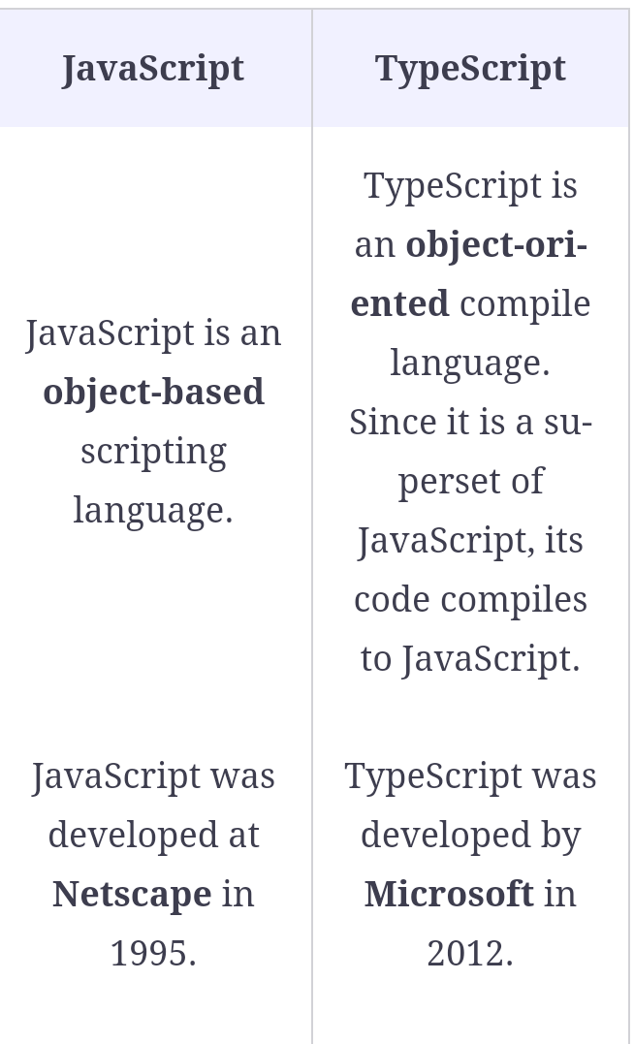

Slide 22
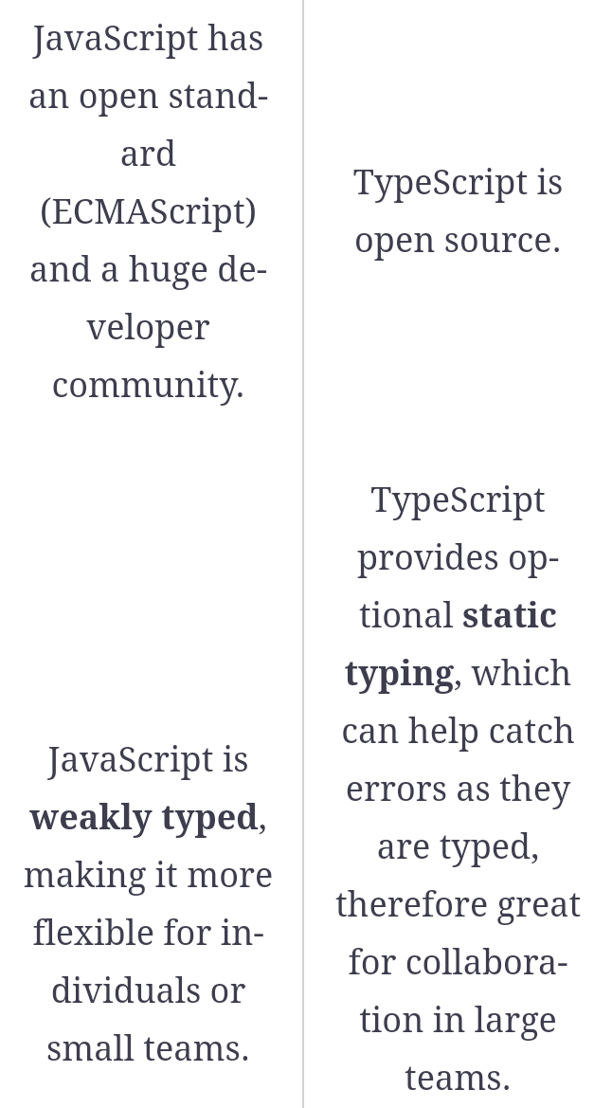

Slide 23
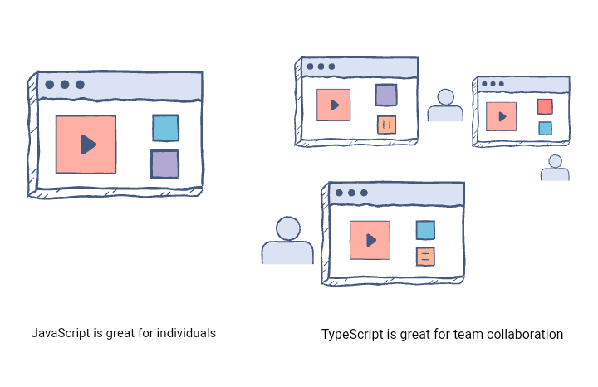

Slide 24
Advantages of using TypeScript over JavaScript
TypeScript can point out compilation errors at the time of development, which JavaScript can not do because it is an interpreted language
TypeScript, as mentioned above, offers static typing which allows catching type errors at compile time and therefore gives a less painful development experience
Perhaps the biggest feature that TypeScript provides over JavaScript is Type-Checking, which can prevent bugs

Slide 25
Angular Forms
Validating form input,
Template-driven forms,
Reactive forms

Slide 26
Angular Forms
In Angular 7, there are 2 approaches to handle user's input through forms:
Reactive forms
Template-driven forms

Slide 27
Reactive Forms
Reactive forms are more robust.
Reactive forms are more scalable, reusable, and testable.
They are most preferred to use if forms are a key part of your application, or your application is already built using reactive patterns.
In both cases, reactive forms are best to use.

Slide 28
Template-driven Forms
Template-driven forms are best if you want to add a simple form to your application. For example: email list signup form.
Template-driven forms are easy to use in the application but they are not as scalable as Reactive forms.
Template-driven forms are mainly used if your application's requires a very basic form and logic. It can easily be managed in a template.

Slide 29
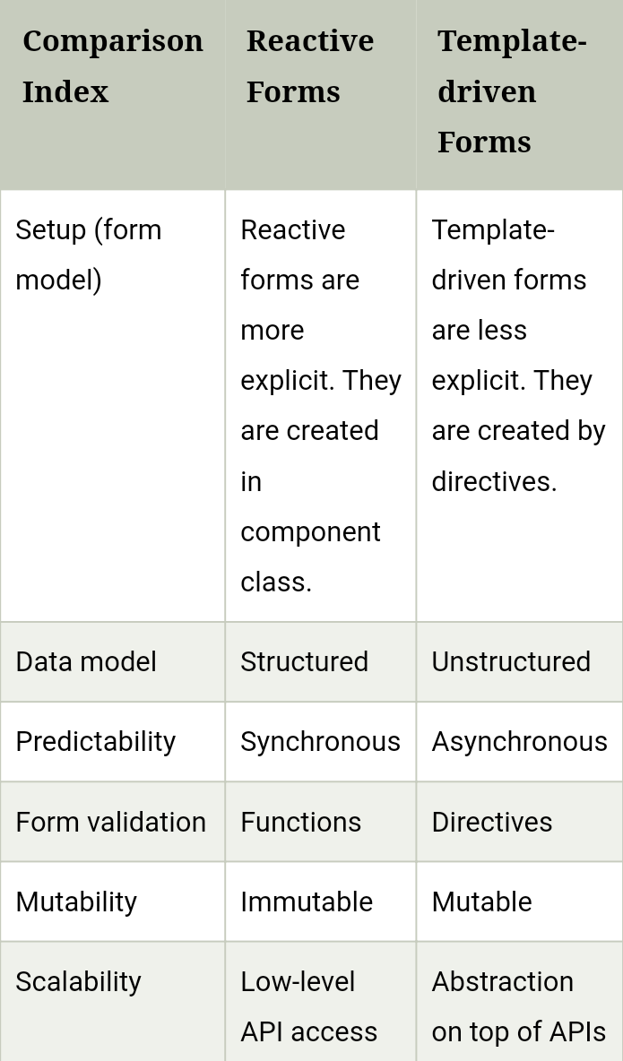

Slide 30
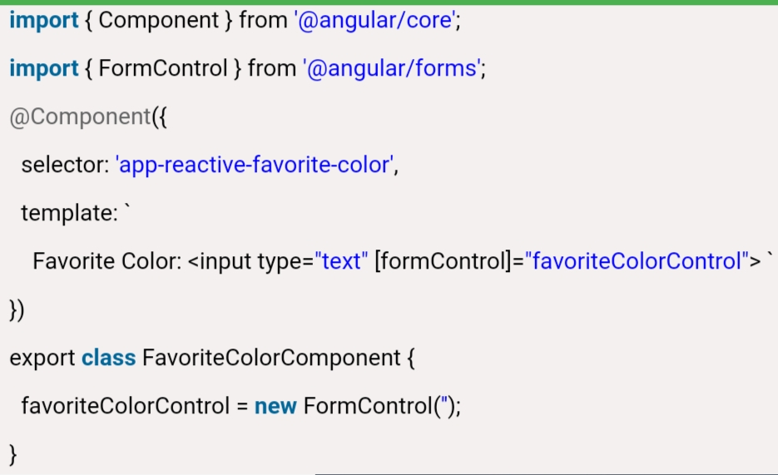
Form model setup in Reactive forms

Slide 31
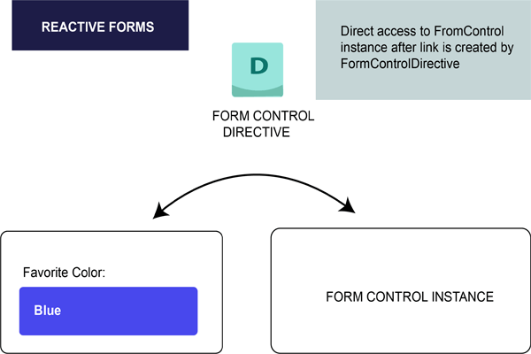

Slide 32
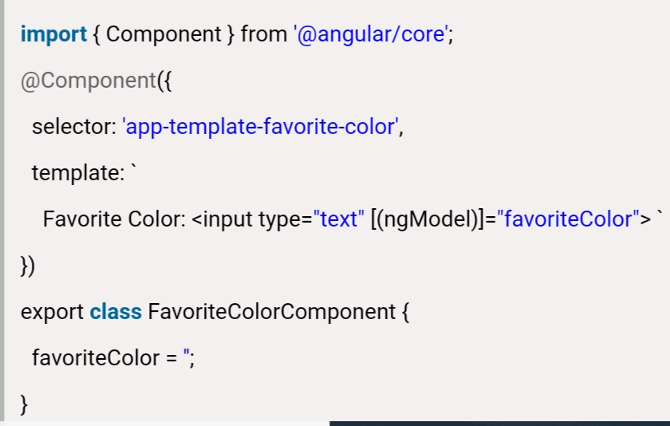
Form model setup in Template-driven Forms

Slide 33
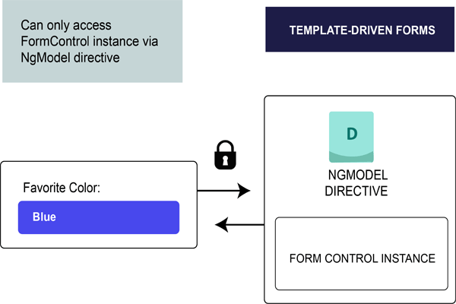

Slide 34
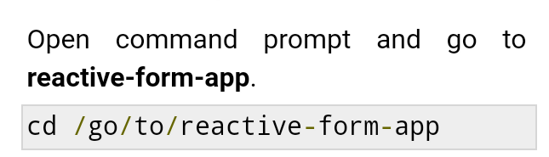
Angular - Form Validation
Form validation is an important part of web application. It is used to validate whether the user input is in correct format or not.
RequiredValidator

Slide 35
Replace the below code in test.component.ts file.
import { Component, OnInit } from '@angular/core';
//import validator and FormBuilder
import { FormGroup, FormControl, Validators, FormBuilder } from '@angular/forms';
@Component({
selector: 'app-test',
templateUrl: './test.component.html',
styleUrls: ['./test.component.css']
})
export class TestComponent implements OnInit {
//Create FormGroup
requiredForm: FormGroup;
constructor(private fb: FormBuilder) {
this.myForm();
}
//Create required field validator for name
myForm() {
this.requiredForm = this.fb.group({
name: ['', Validators.required ]
});
}
ngOnInit()
{
}
}

Slide 36
Add the below code inside test.component.html file.
<div>
<h2>
Required Field validation
</h2>
<form [formGroup]="requiredForm" novalidate>
<div class="form-group">
<label class="center-block">Name:
<input class="form-control" formControlName="name">
</label>
</div>
<div *ngIf="requiredForm.controls['name'].invalid && requiredForm.controls['name'].touched" class="alert alert-danger">
<div *ngIf="requiredForm.controls['name'].errors.required">
Name is required.
</div>
</div>
</form>
<p>Form value: {{ requiredForm.value | json }}</p>
<p>Form status: {{ requiredForm.status | json }}</p>
</div>

Slide 37
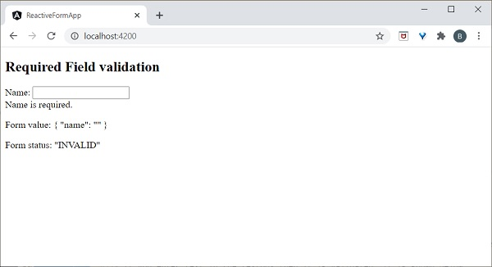

Slide 38
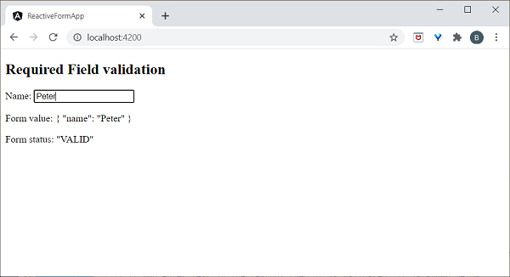

Slide 39

PatternValidator
PatternValidator is used to validate regex pattern. Let’s perform simple email validation.
Open command prompt and to reactive-form-app.

Slide 40
Replace below code in test.component.ts file −
import { Component, OnInit } from '@angular/core';
import { FormGroup, FormControl, Validators, FormBuilder } from
'@angular/forms';
@Component({
selector: 'app-test',
templateUrl: './test.component.html',
styleUrls: ['./test.component.css']
})
export class TestComponent implements OnInit {
requiredForm: FormGroup;
constructor(private fb: FormBuilder) {
this.myForm();
}
myForm() {
this.requiredForm = this.fb.group({
email: ['', [Validators.required,
Validators.pattern("^[a-z0-9._%+-]+@[a-z0-9.-]+\.[a-z]{2,4}$")] ]
});
}
ngOnInit()
{
}
}

Slide 41
Update below code in test.component.html
<div>
<h2>
Pattern validation
</h2>
<form [formGroup]="requiredForm" novalidate>
<div class="form-group">
<label class="center-block">Email:
<input class="form-control" formControlName="email">
</label>
</div>
<div *ngIf="requiredForm.controls['email'].invalid && requiredForm.controls['email'].touched" class="alert alert-danger">
<div *ngIf="requiredForm.controls['email'].errors.required">
Email is required.
</div>
</div>
</form>
<p>Form value: {{ requiredForm.value | json }}</p>
<p>Form status: {{ requiredForm.status | json }}</p>
</div>

Slide 42
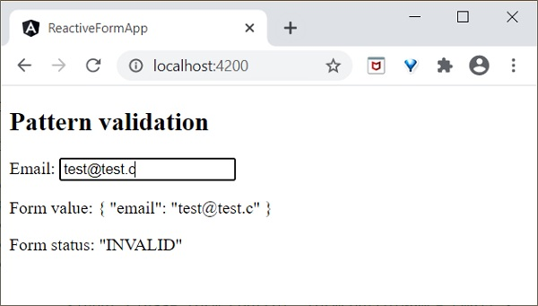

Slide 43
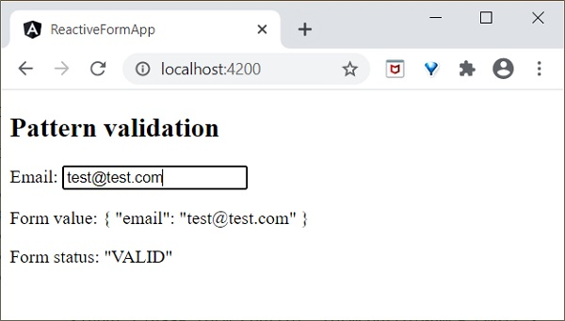

Slide 44
Component Communication in Angular
Pass data from URL,
Router parameters,
Query params,
Pass data through @Input and @Output,
Pass data through a service using observables

Slide 45
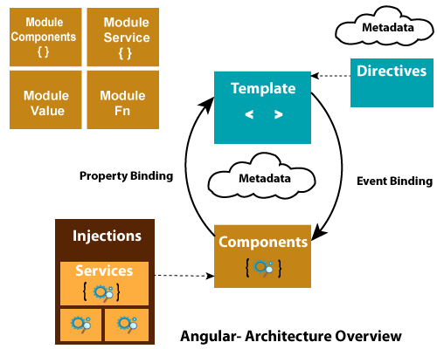

Slide 46
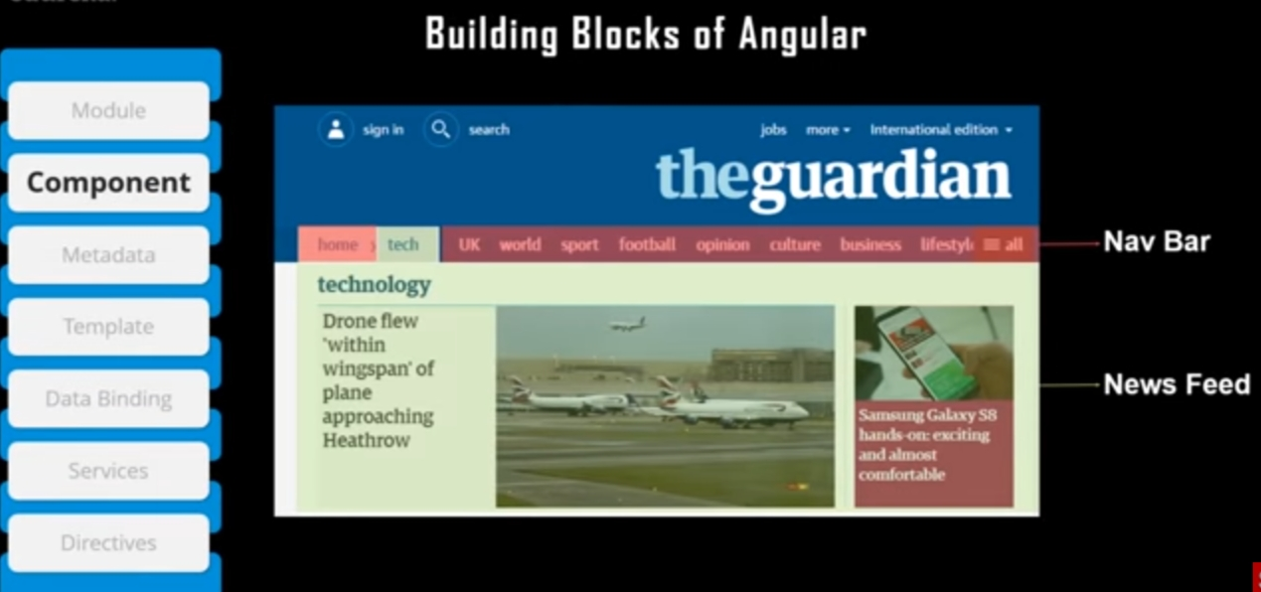

Slide 47
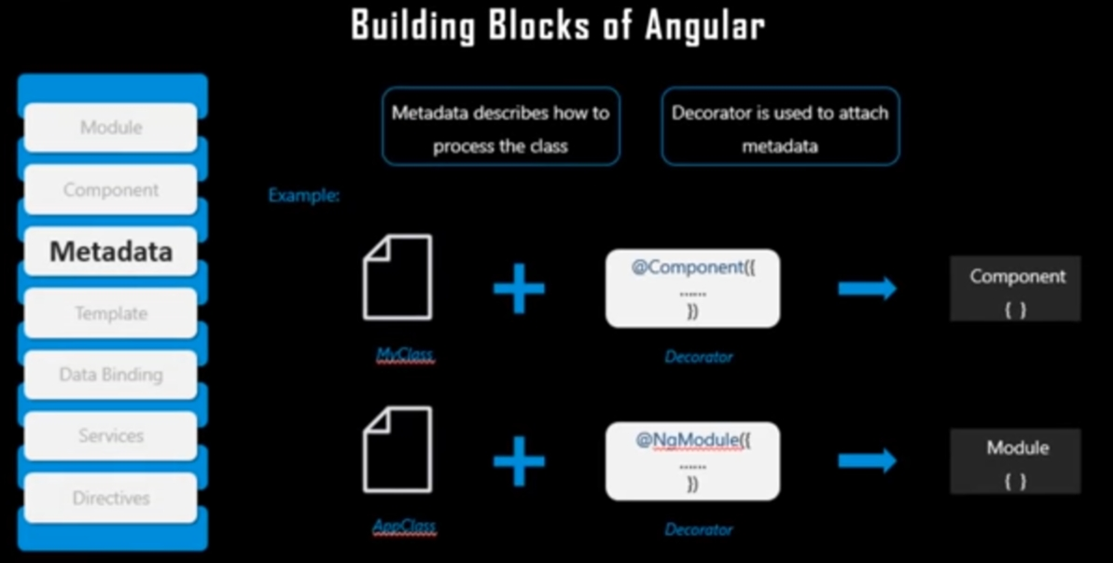

Slide 48
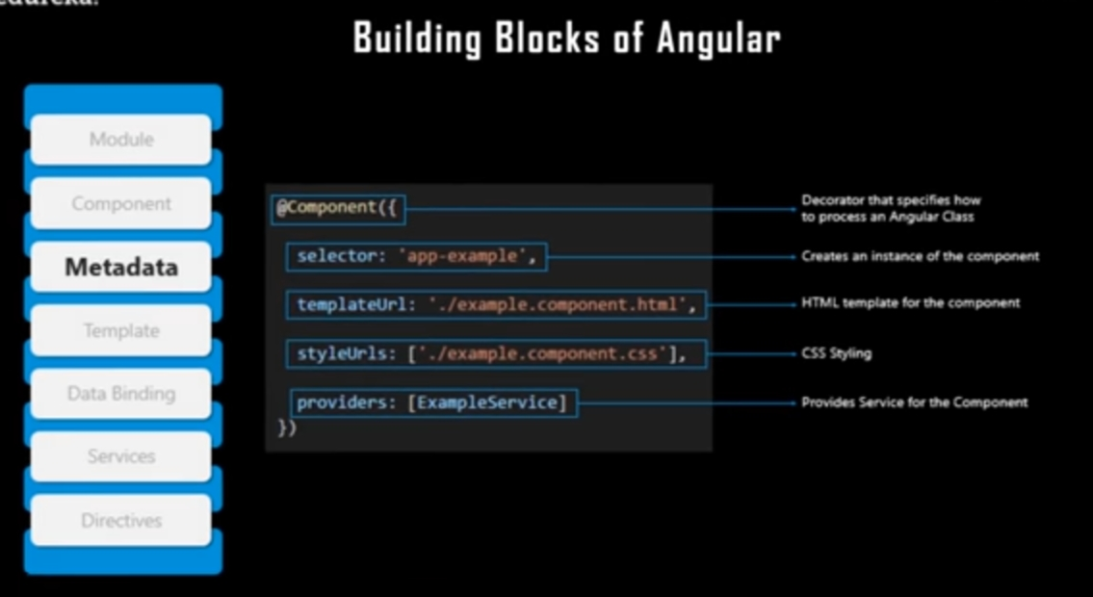

Slide 49
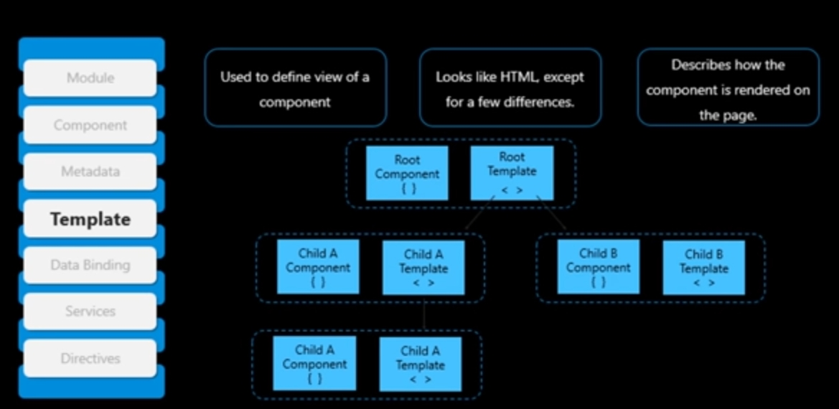

Slide 50
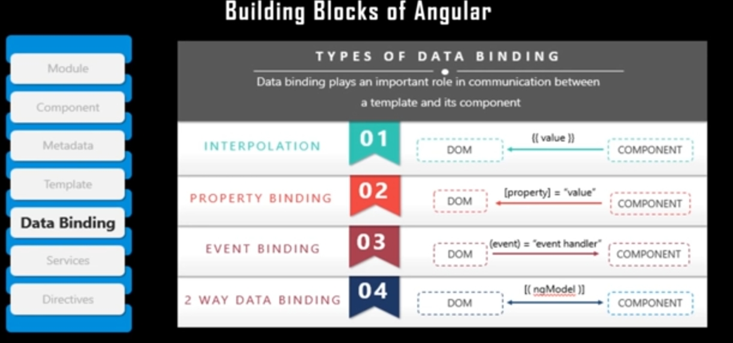

Slide 51
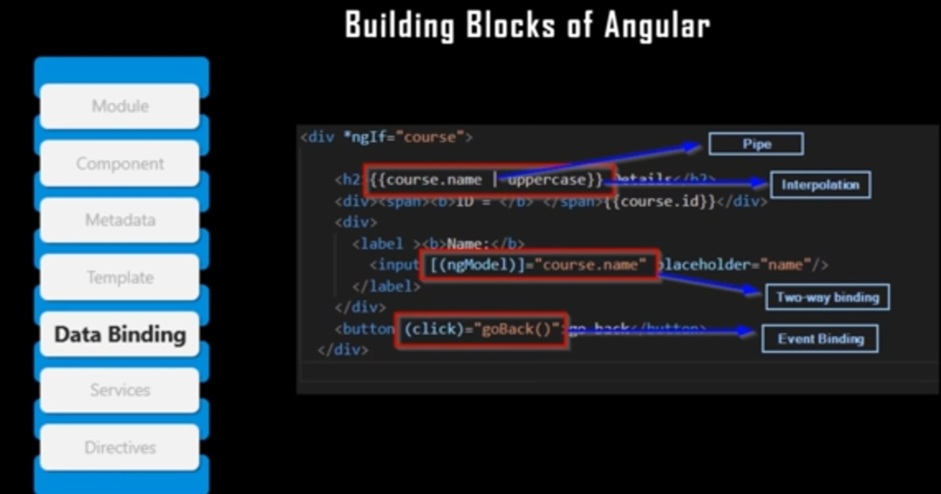

Slide 52
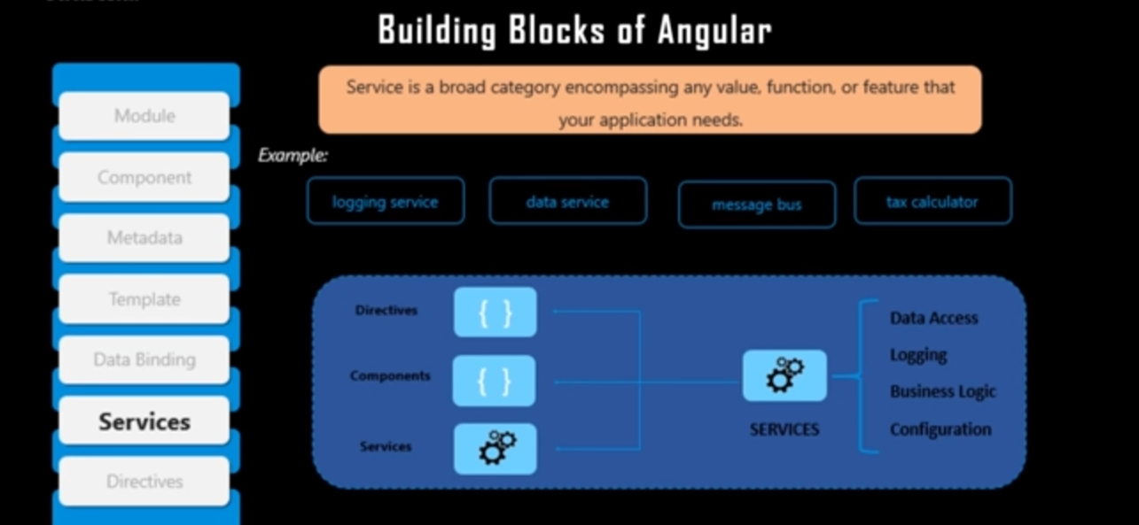

Slide 53
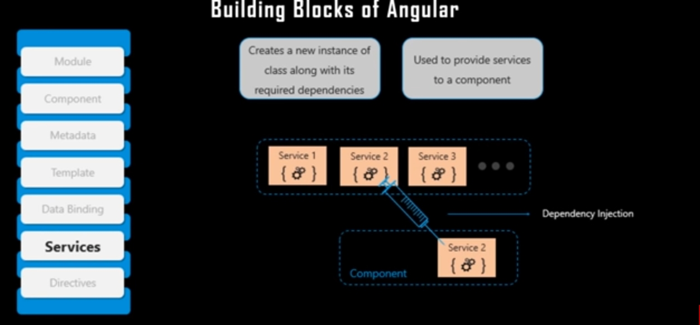

Slide 54
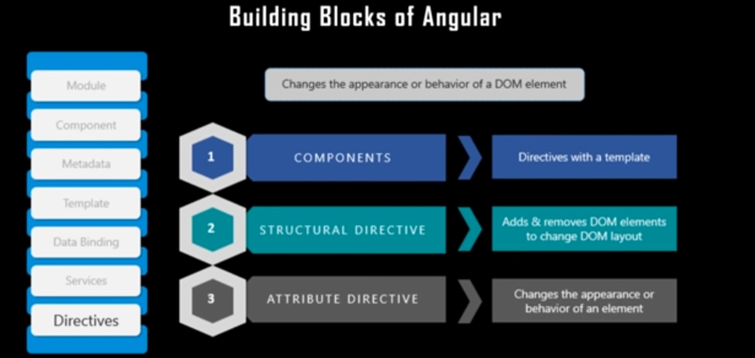

Slide 55
Angular Components
Components are the key features of Angular. The whole application is built by using different components.
The core idea behind Angular is to build components. They make your complex application into reusable parts which you can reuse very easily.
Components are used to build webpages in Angular but they require modules to bundle them together. Now, you have to register our new components in module.

Slide 56
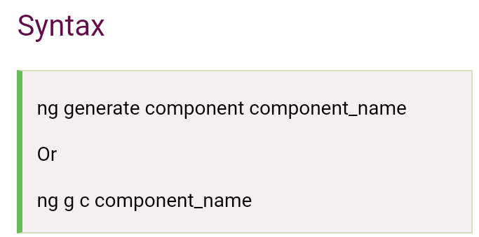
Creating component with CLI

Slide 57
Routing
Navigation in Angular, Angular Router, Route order

Slide 58
Routing
In Angular , Router is an NgModule which provides a service that facilitates developers to define a navigation path among the different application states and view hierarchies in their app.
It works in the same way as a browser's navigation works. i.e.:
Enter a URL in the address bar and the browser will navigate to that corresponding page.
Click the link on a page and the browser will navigate to a new page.
Click the browser's back or forward buttons and the browser will navigate backward or forward according to your seen history pages.

Slide 59
How does Router work?
The router maps URL-like paths to views instead of pages. Whenever a user performs an action, such as clicking a link that would load a new page in the browser, the router intercepts the browser's behavior, and shows or hides view hierarchies.
If the router finds that the current application state requires particular functionality, and the module that defines it hasn't been loaded, the router can lazy-load the module on demand.

Slide 60
Angular pipes

Slide 61
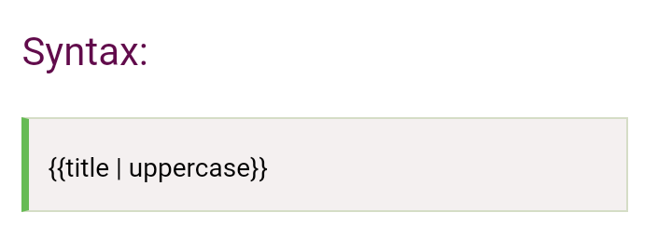
Angular Pipes
Angular Pipes takes data as input and formats or transform the data to display in the template.
We use them to change the appearance of the data before presenting it to the user.
It is denoted by symbol |

Slide 62
Pipe takes integers, strings, arrays, and date as input separated with |.
It transforms the data in the format as required and displays the same in the browser.

Slide 63
Define a variable named "title" in component.ts file.
import { Component } from '@angular/core';
@Component({
selector: 'app-root',
templateUrl: './app.component.html',
styleUrls: ['./app.component.css']
})
export class AppComponent {
title = 'my-first-app';
}

Slide 64
Use the pipe symbol in component.html file
<h1>
{{ title | uppercase }} <br/></h1>
<h1>
{{ title | lowercase }} <br/></h1>

Slide 65
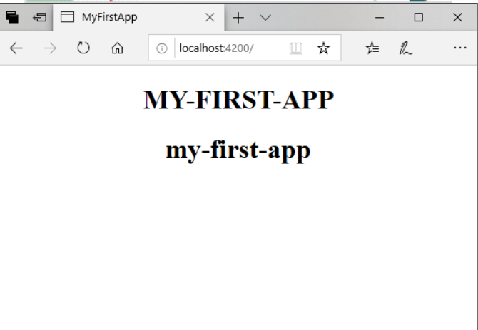

Slide 66
Angular Built-in Pipes
Lowercasepipe
Uppercasepipe
Datepipe
Currencypipe
Jsonpipe
Percentpipe
Decimalpipe
Slicepipe

Slide 67
component.ts
import { Component } from '@angular/core';
@Component({
selector: 'app-root',
templateUrl: './app.component.html',
styleUrls: ['./app.component.css']
})
export class AppComponent {
title = 'my-first-app';
todaydate = new Date();
jsonval = {name: 'Alex', age: '25', address:{a1: 'Paris', a2: 'France'}};
months = ['Jan', 'Feb', 'Mar', 'April', 'May', 'Jun',
'July', 'Aug', 'Sept', 'Oct', 'Nov', 'Dec'];
}

Slide 68
component.html
<div style = "width:100%;">
<div style = "width:40%;float:left;border:solid 1px black;">
<h1>Uppercase Pipe</h1>
<b>{{title | uppercase}}</b><br/>
<h1>Lowercase Pipe</h1>
<b>{{title | lowercase}}</b>
<h1>Currency Pipe</h1>
<b>{{6589.23 | currency:"USD"}}</b><br/>
<b>{{6589.23 | currency:"USD":true}}</b> //Boolean true is used to get the sign of the currency.
<h1>Date pipe</h1>
<b>{{todaydate | date:'d/M/y'}}</b><br/>
<b>{{todaydate | date:'shortTime'}}</b>
<h1>Decimal Pipe</h1>
<b>{{ 454.78787814 | number: '3.4-4' }}</b> // 3 is for main integer, 4 -4 are for integers to be displayed.
</div>
<div style = "width:40%;float:left;border:solid 1px black;">
<h1>Json Pipe</h1>
<b>{{ jsonval | json }}</b>
<h1>Percent Pipe</h1>
<b>{{00.54565 | percent}}</b>
<h1>Slice Pipe</h1>
<b>{{months | slice:2:6}}</b>
// here 2 and 6 refers to the start and the end index
</div>
</div>

Slide 69
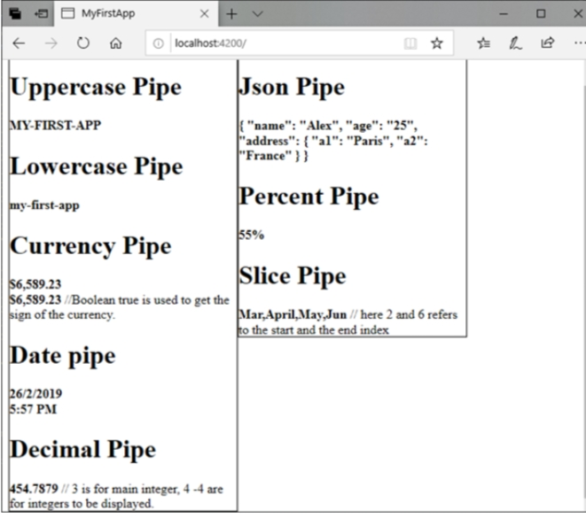

Slide 70
How to create a custom pipe?
To create a custom pipe, create a new ts file and use the code according to the work you have to do.
You have to import Pipe, PipeTransform from Angular/Core. Let's create a sqrt custom pipe.

Slide 71
component.ts
import {Pipe, PipeTransform} from '@angular/core';
@Pipe ({
name : 'sqrt'
})
export class SqrtPipe implements PipeTransform {
transform(val : number) : number {
return Math.sqrt(val);
}
}

Slide 72
Module.ts file:
import { BrowserModule } from '@angular/platform-browser';
import { NgModule } from '@angular/core';
import { AppComponent } from './app.component';
import { NewCmpComponent } from './new-cmp/new-cmp.component';
import { ChangeTextDirective } from './change-text.directive';
import { SqrtPipe } from './app.sqrt';
@NgModule({
declarations: [
SqrtPipe,
AppComponent,
NewCmpComponent,
ChangeTextDirective
],
imports: [
BrowserModule
],
providers: [],
bootstrap: [AppComponent]
})
export class AppModule { }

Slide 73
component.html
<h1>Example of Custom Pipe</h1>
<h2>Square root of 625 is: {{625 | sqrt}}</h2><br/>
<h2>Square root of 169 is: {{169 | sqrt}}</h2>

Slide 74
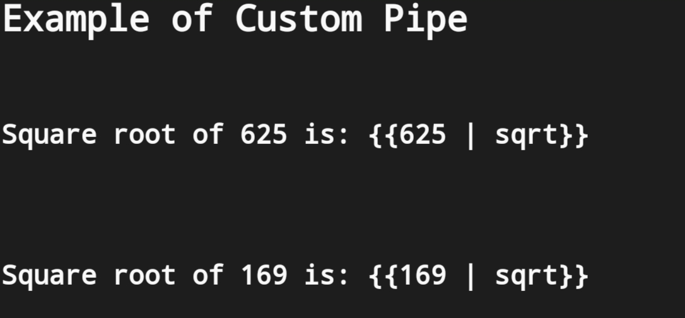

Slide 75


